Slide 1
CS162 Operating Systems and Systems Programming Lecture 19 File Systems (Con’t), MMAP
October 5th, 2018
Prof. Ion Stoica
http://cs162.eecs.Berkeley.edu

Slide 2
Our first filesystem: FAT (File Allocation Table)
The most commonly used filesystem in the world!
Assume (for now) we have a way to translate a path to a “file number”
i.e., a directory structure
Disk Storage is a collection of Blocks
Just hold file data (offset o = < B, x >)
Example: file_read 31, < 2, x >
Index into FAT with file number
Follow linked list to block
Read the block from disk into memory
FAT
Disk Blocks
file number
0:
0:
31:
File 31, Block 0
File 31, Block 1
File 31, Block 2
N-1:
N-1:
memory

Slide 3
Directory Structure (cont’d)
How many disk accesses to resolve “/my/book/count”?
Read in file header for root (fixed spot on disk)
Read in first data block for root
Table of file name/index pairs. Search linearly – ok since directories typically very small
Read in file header for “my”
Read in first data block for “my”; search for “book”
Read in file header for “book”
Read in first data block for “book”; search for “count”
Read in file header for “count”
Current working directory: Per-address-space pointer to a directory (inode) used for resolving file names
Allows user to specify relative filename instead of absolute path (say CWD=“/my/book” can resolve “count”)

Slide 4
Many Huge FAT Security Holes!
FAT has no access rights
FAT has no header in the file blocks
Just gives an index into the FAT
(file number = block number)

Slide 5
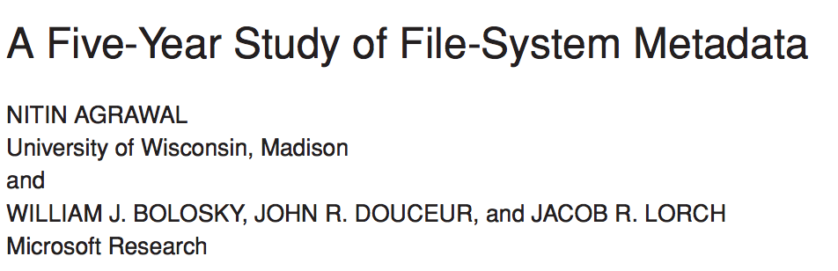
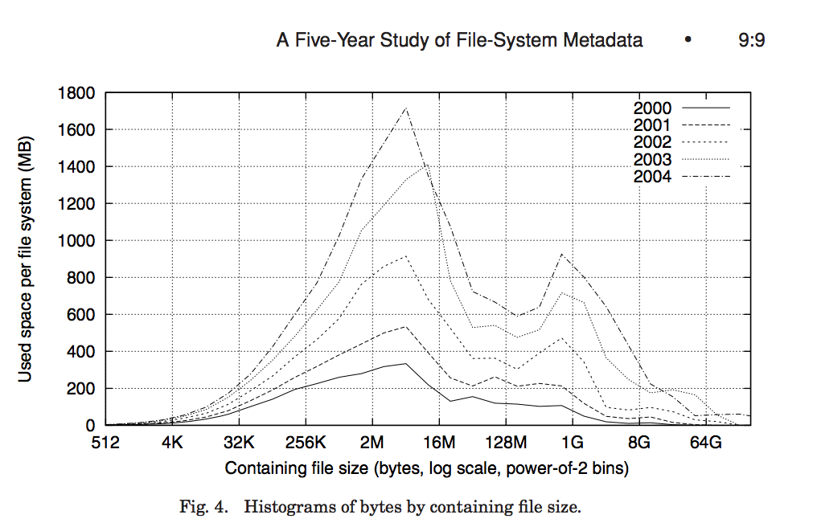
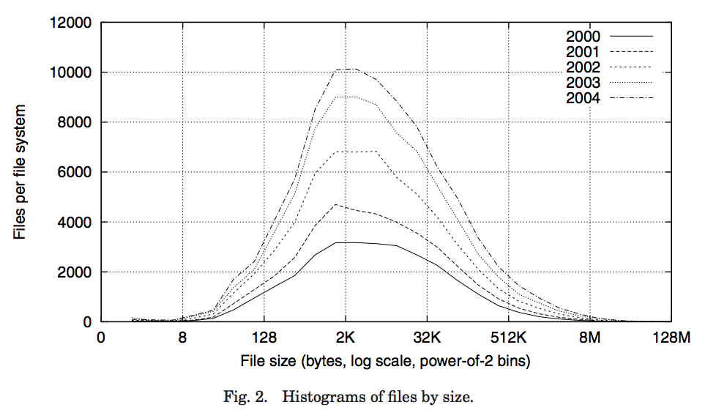
Characteristics of Files
Notes:
FAST’07 paper
Data from >10K PCs at MS
May be skewed by corporate distros

Slide 6
Characteristics of Files
Most files are small, growing numbers of files over time
Notes:
From 30k to 90k files

Slide 7
Characteristics of Files
Most of the space is occupied by the rare big ones
Notes:
15% file size growth/year
New peaks are DB, video, and blob (email) files
Median capacity from 5 to 40GB

Slide 8
Unix File System (1/2)
Original inode format appeared in BSD 4.1
Berkeley Standard Distribution Unix
Part of your heritage!
Similar structure for Linux Ext2/3
File Number is index into inode arrays
Multi-level index structure
Great for little and large files
Asymmetric tree with fixed sized blocks

Slide 9
Unix File System (2/2)
Metadata associated with the file
Rather than in the directory that points to it
UNIX Fast File System (FFS) BSD 4.2 Locality Heuristics:
Block group placement
Reserve space
Scalable directory structure

Slide 10
File Attributes
inode metadata

Slide 11
File Attributes
inode metadata
User
Group
9 basic access control bits
- UGO x RWX
Setuid bit
- execute at owner permissions rather than user
Setgid bit
- execute at group’s permissions

Slide 12
Data Storage
Small files: 12 pointers direct to data blocks
Direct pointers
4kB blocks ⇒ sufficient for files up to 48KB

Slide 13
Data Storage
Large files: 1,2,3 level indirect pointers
Indirect pointers
- point to a disk block
containing only pointers
- 4 kB blocks => 1024 ptrs
=> 4 MB @ level 2
=> 4 GB @ level 3
=> 4 TB @ level 4
48 KB
+4 MB
+4 GB
+4 TB

Slide 14
UNIX BSD 4.2 (1984) (1/2)
Same as BSD 4.1 (same file header and triply indirect blocks), except incorporated ideas from Cray Operating System:
Uses bitmap allocation in place of freelist
Attempt to allocate files contiguously
10% reserved disk space
Skip-sector positioning (mentioned later)

Slide 15
UNIX BSD 4.2 (1984) (2/2)
Problem: When create a file, don’t know how big it will become (in UNIX, most writes are by appending)
How much contiguous space do you allocate for a file?
In BSD 4.2, just find some range of free blocks
Put each new file at the front of different range
To expand a file, you first try successive blocks in bitmap, then choose new range of blocks
Also in BSD 4.2: store files from same directory near each other
Fast File System (FFS)
Allocation and placement policies for BSD 4.2

Slide 16
Attack of the Rotational Delay
Problem 2: Missing blocks due to rotational delay
Issue: Read one block, do processing, and read next block. In meantime, disk has continued turning: missed next block! Need 1 revolution/block!
Solution1: Skip sector positioning (“interleaving”)
Place the blocks from one file on every other block of a track: give time for processing to overlap rotation
Can be done by OS or in modern drives by the disk controller
Skip Sector
Track Buffer
(Holds complete track)

Slide 17
Attack of the Rotational Delay
Problem 2: Missing blocks due to rotational delay
Issue: Read one block, do processing, and read next block. In meantime, disk has continued turning: missed next block! Need 1 revolution/block!
Solution 2: Read ahead: read next block right after first, even if application hasn’t asked for it yet
This can be done either by OS (read ahead)
By disk itself (track buffers) - many disk controllers have internal RAM that allows them to read a complete track
Note: Modern disks + controllers do many things “under the covers”
Track buffers, elevator algorithms, bad block filtering
Skip Sector
Track Buffer
(Holds complete track)

Slide 18
Where are inodes Stored?
In early UNIX and DOS/Windows’ FAT file system, headers stored in special array in outermost cylinders
Header not stored anywhere near the data blocks
To read a small file, seek to get header, seek back to data
Fixed size, set when disk is formatted
At formatting time, a fixed number of inodes are created
Each is given a unique number, called an “inumber”

Slide 19
Where are inodes Stored?
Later versions of UNIX moved the header information to be closer to the data blocks
Often, inode for file stored in same “cylinder group” as parent directory of the file (makes an ls of that directory run fast)
Pros:
UNIX BSD 4.2 puts bits of file header array on many cylinders
For small directories, can fit all data, file headers, etc. in same cylinder ⇒ no seeks!
File headers much smaller than whole block (a few hundred bytes), so multiple headers fetched from disk at same time
Reliability: whatever happens to the disk, you can find many of the files (even if directories disconnected)
Part of the Fast File System (FFS)
General optimization to avoid seeks

Slide 20
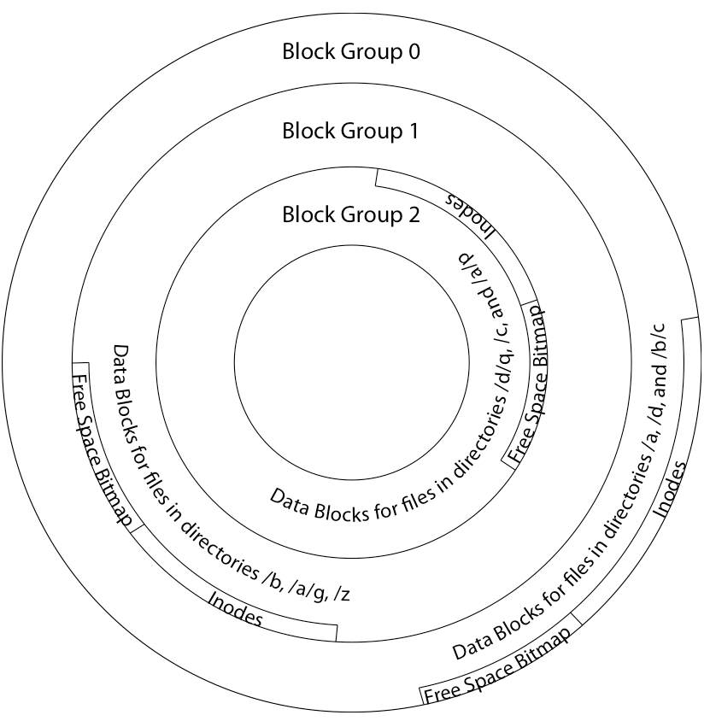
4.2 BSD Locality: Block Groups
File system volume is divided into a set of block groups
Close set of tracks
Data blocks, metadata, and free space interleaved within block group
Avoid huge seeks between user data and system structure
Put directory and its files in common block group

Slide 21
4.2 BSD Locality: Block Groups
First-Free allocation of new file blocks
To expand file, first try successive blocks in bitmap, then choose new range of blocks
Few little holes at start, big sequential runs at end of group
Avoids fragmentation
Sequential layout for big files
Important: keep 10% or more free!
Reserve space in the Block Group

Slide 22
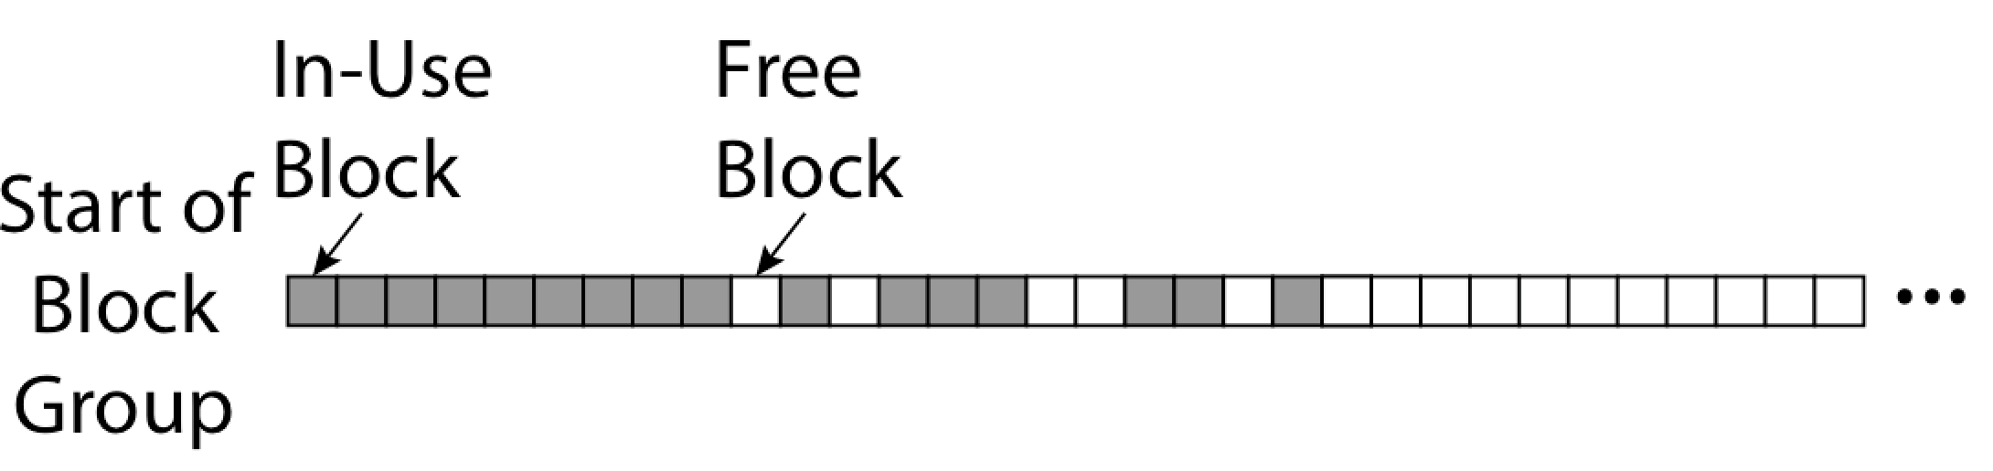
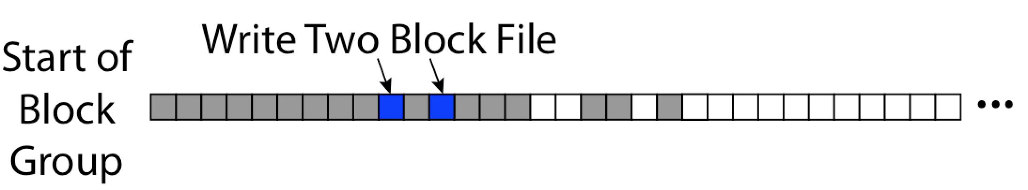
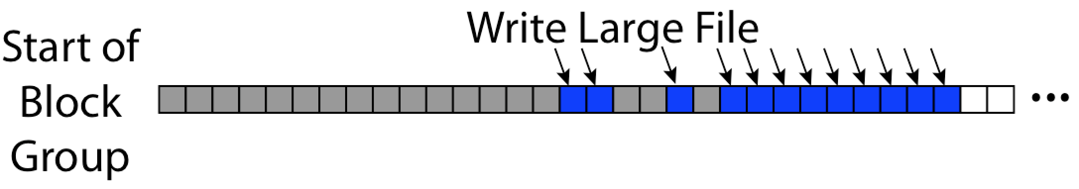
UNIX 4.2 BSD FFS First Fit Block Allocation
Fills in the small holes at the start of block group
Avoids fragmentation, leaves contiguous free space at end

Slide 23
UNIX 4.2 BSD FFS
Pros
Efficient storage for both small and large files
Locality for both small and large files
Locality for metadata and data
No defragmentation necessary!
Cons
Inefficient for tiny files (a 1 byte file requires both an inode and a data block)
Inefficient encoding when file is mostly contiguous on disk
Need to reserve 10-20% of free space to prevent fragmentation

Slide 24
break

Slide 25
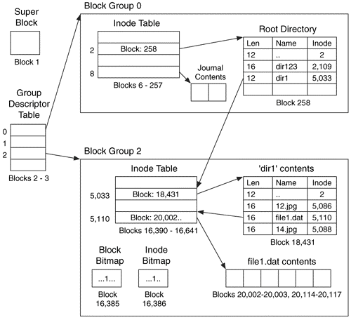
Linux Example: Ext2/3 Disk Layout
Disk divided into block groups
Provides locality
Each group has two block-sized bitmaps (free blocks/inodes)
Block sizes settable at format time: 1K, 2K, 4K, 8K…
Actual inode structure similar to 4.2 BSD
with 12 direct pointers
Ext3: Ext2 with Journaling
Several degrees of protection with comparable overhead
Example: create a file1.dat under /dir1/ in Ext3

Slide 26
A bit more on directories
Stored in files, can be read, but typically don’t
System calls to access directories
open / creat traverse the structure
mkdir /rmdir add/remove entries
link / unlink (rm)
Link existing file to a directory
Not in FAT !
Forms a DAG
When can file be deleted?
Maintain ref-count of links to the file
Delete after the last reference is gone
libc support
DIR * opendir (const char *dirname)
struct dirent * readdir (DIR *dirstream)
int readdir_r (DIR *dirstream, struct dirent *entry, struct dirent **result)
/usr
/usr/lib
/usr/lib4.3
/usr/lib/foo
/usr/lib4.3/foo

Slide 27
Links
Hard link
Sets another directory entry to contain the file number for the file
Creates another name (path) for the file
Each is “first class”
Soft link or Symbolic Link or Shortcut
Directory entry contains the path and name of the file
Map one name to another name

Slide 28
Large Directories: B-Trees (dirhash)
in FreeBSD, NetBSD, OpenBSD

Slide 29
NTFS
New Technology File System (NTFS)
Default on Microsoft Windows systems
Variable length extents
Rather than fixed blocks
Everything (almost) is a sequence of <attribute:value> pairs
Meta-data and data
Mix direct and indirect freely
Directories organized in B-tree structure by default

Slide 30
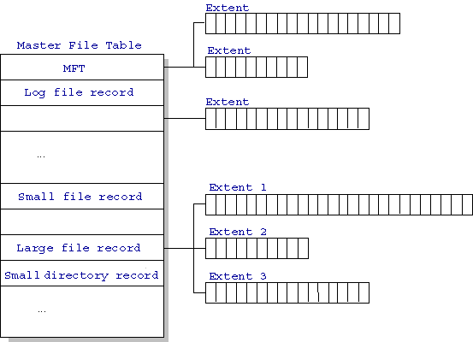
NTFS
Master File Table
Database with Flexible 1KB entries for metadata/data
Variable-sized attribute records (data or metadata)
Extend with variable depth tree (non-resident)
Extents – variable length contiguous regions
Block pointers cover runs of blocks
Similar approach in Linux (ext4)
File create can provide hint as to size of file
Journaling for reliability
Discussed later
http://ntfs.com/ntfs-mft.htm

Slide 31
NTFS Small File
Create time, modify time, access time,
Owner id, security specifier, flags (RO, hidden, sys)
data attribute
Attribute list

Slide 32
NTFS Medium File

Slide 33
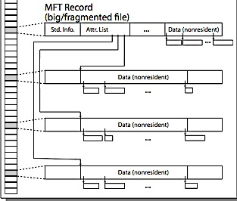
NTFS Multiple Indirect Blocks

Slide 35
Memory Mapped Files
Traditional I/O involves explicit transfers between buffers in process address space to/from regions of a file
This involves multiple copies into caches in memory, plus system calls
What if we could “map” the file directly into an empty region of our address space
Implicitly “page it in” when we read it
Write it and “eventually” page it out
Executable files are treated this way when we exec the process!!

Slide 36
Recall: Who Does What, When?
Process
virtual address
physical address
MMU
page#
PT
instruction
frame#
retry
page fault
offset
exception
frame#
Operating System
offset
update PT entry
Page Fault Handler
load page from disk
scheduler

Slide 37
Using Paging to mmap() Files
Process
virtual address
physical address
MMU
page#
PT
instruction
frame#
offset
retry
page fault
exception
Read File contents
from memory!
Operating System
Create PT entries
for mapped region
as “backed” by file
Page Fault Handler
File
scheduler
mmap() file to region of VAS

Slide 38
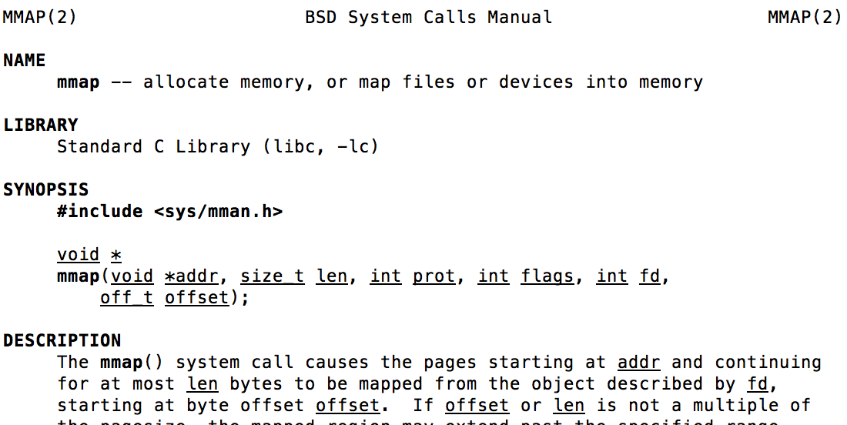
mmap() system call
May map a specific region or let the system find one for you
Tricky to know where the holes are
Used both for manipulating files and for sharing between processes

Slide 39
An mmap() Example
#include <sys/mman.h> /* also stdio.h, stdlib.h, string.h, fcntl.h, unistd.h */
int something = 162;
int main (int argc, char *argv[]) {
int myfd;
char *mfile;
printf("Data at: %16lx\n", (long unsigned int) &something);
printf("Heap at : %16lx\n", (long unsigned int) malloc(1));
printf("Stack at: %16lx\n", (long unsigned int) &mfile);
/* Open the file */
myfd = open(argv[1], O_RDWR | O_CREAT);
if (myfd < 0) { perror("open failed!");exit(1); }
/* map the file */
mfile = mmap(0, 10000, PROT_READ|PROT_WRITE, MAP_FILE|MAP_SHARED, myfd, 0);
if (mfile == MAP_FAILED) {perror("mmap failed"); exit(1);}
printf("mmap at : %16lx\n", (long unsigned int) mfile);
puts(mfile);
strcpy(mfile+20,"Let's write over it");
close(myfd);
return 0;
}
$ ./mmap test
Data at: 105d63058
Heap at : 7f8a33c04b70
Stack at: 7fff59e9db10
mmap at : 105d97000
This is line one
This is line two
This is line three
This is line four
$ cat test
This is line one
ThiLet's write over its line three
This is line four

Slide 40
File System Summary (1/2)
File System:
Transforms blocks into Files and Directories
Optimize for size, access and usage patterns
Maximize sequential access, allow efficient random access
Projects the OS protection and security regime (UGO vs ACL)
File defined by header, called “inode”
Naming: translating from user-visible names to actual sys resources
Directories used for naming for local file systems
Linked or tree structure stored in files
Multilevel Indexed Scheme
inode contains file info, direct pointers to blocks, indirect blocks, doubly indirect, etc..
NTFS: variable extents not fixed blocks, tiny files data is in header

Slide 41
File System Summary (2/2)
4.2 BSD Multilevel index files
Inode contains ptrs to actual blocks, indirect blocks, double indirect blocks, etc.
Optimizations for sequential access: start new files in open ranges of free blocks, rotational optimization
File layout driven by freespace management
Integrate freespace, inode table, file blocks and dirs into block group
Deep interactions between mem management, file system, sharing
mmap(): map file or anonymous segment to memory

